Slide 1
Compensation at RIT
A Workshop by the RIT AAUP Chapter

Slide 2
Faculty Governance Scale
What score do you give RIT?

Slide 3
Faculty Governance Scale - I
The Administration understands and respects the principle of academic freedom.
Faculty have access to university financial data
Faculty exercise control over the curriculum
Faculty Senate (Assembly, or similar governance structure) participates in institutional decision-making
All faculty groups (tenure/tenure-track, full-time lecturer, adjunct, etc.) work together on governance-related issues
Faculty participate in presidential search/selection
Faculty participate in provost search/selection

Slide 4
Faculty Governance Scale - II
8. Faculty participate in dean search/selection
9. Faculty participate in department chair/head search/selection
10. There is a robust, even-handed faculty grievance policy
11. Faculty collaborate with staff in governance-related issues
12. Faculty collaborate with students in governance-related issues
13. Faculty have access to the Board of Trustees

Slide 5
Faculty Governance Scale - III
Interpretation
≤20 Horrible
21-30 Could be worse
31-40 D
41-50 C
51-60 C+
61-70 B
71-80 B+
>81 Exceptional

Slide 6



https://ritAAUP.org
https://aaup.org/join
Notes:
AAUP was founded in 1915 in NYC to defend academic freedom in higher ed.
"The RIT AAUP Chapter was formed over 20 years ago and has been through multiple lapses and revivals." This latest revival being last year.
We regularly communicate and collaborate with the Faculty Senate, but are independent from RIT administration

Slide 7
Key chapter goals this year
Survey of RIT adjunct professors (will go out mid-October)
Building back the chapter membership across RIT faculty – grow a mutually-supportive academic community that can address local issues

Slide 8
Key chapter goals this year
A faculty member slot on RIT Board of Trustees
Support of and collaboration with other local/regional chapters and organizations (regional conference Oct 24 at SJFU)

Slide 9
Key chapter goals this year
Support of and collaboration with students
Robust community communication (e.g., https://ritaaup.org) and ability to mobilize as needed
… your suggestions are welcome

Slide 10
Demystifying RIT’s Approach to Compensation
Today’s Agenda

Slide 11
Agenda

Slide 12
Agenda
Faculty Governance Scale
RIT Faculty Governance
US News & Carnegie
COACHE
Historical Increments/CPI
Some of Our Neighbors
IPEDS
The Tortured History of RIT Benchmarks
The Mysterious 85th %ile
Nothing New Under The Sun
Computing your compa-ratio
Recourse?
Benefits
Is There Money?
What Is To Be Done?

Slide 13
Faculty Governance

Slide 14
Article III. Responsibility of the Faculty
B02.3.2 Advice & Recommendations
. . . . . . , the faculty in accordance with their responsibilities as defined in E 06.0 has a responsibility to advise and make recommendations to the appropriate persons or bodies concerning other policies and decisions affecting university development and welfare.

Slide 15
Article III. Responsibility of the Faculty
B02.3.2 Advice & Recommendations
. . . . recommendations include, for example, the appointment, retention, promotion, and tenure of individual faculty; the appointment of administrative and academic officers; faculty personnel policies; student responsibilities and discipline; the academic calendar; the setting of fund-raising priorities; the formulation of priorities for and review of the annual operating budget of the university; the development and expansion of the campus; and the expression of university views on matters of public concern.

Slide 16
Budget & Planning Committee (B02.10.8 )
The Budget and Planning Committee (BPC) shall be the faculty committee on all matters pertaining to university budget and finances. . . . . .

Slide 17
Budget & Planning Committee (B02.10.8 )
The committee shall submit to the Faculty Senate for review and approval academic priorities related to external academic funding.
The committee shall be responsible for presenting an analysis of the budget and other financial matters to the Senate for its review and the executive committee shall forward that review in writing, as adopted by the Senate, to the president and to the University Council. . . . . . .

Slide 18
US News & Carnegie Ranking
Where do we stand?

Slide 19
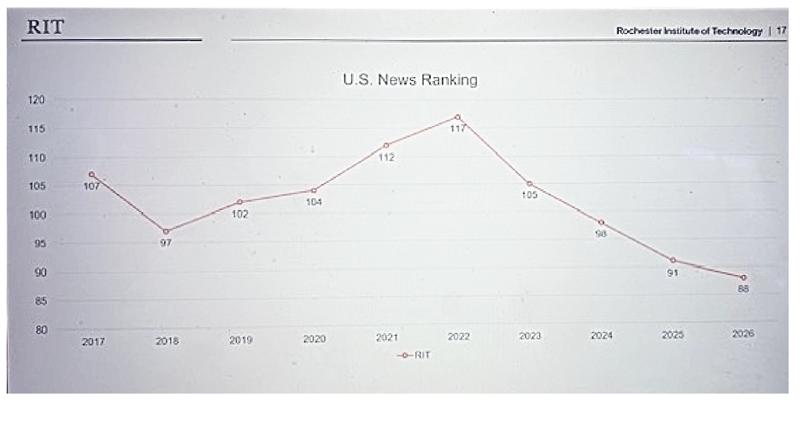
RIT & USNEWS&WORLD REPORT

Slide 20
USNEWS&WORLD sub-scores
Criteria | %Weight | 2026 Rank | 2025 Rank
Graduation & Retention | 21% | 127 | 128
Peer Assessment | 20% | 74 | 71
Social Mobility | 11% | 88 | 85
Faculty Resources | 11% | 108 | 119
Graduation Performance | 10% | 129 | 168
Financial Resources | 8% | 151 | 116
Student Excellence | 5% | 48 | 41
Graduate Earning | 5% | 98 | 98
Borrower Debt | 5% | 398 | 398
Faculty Research | 4% | 132 | 147
Overall |  | 95th | 88th

Slide 21
Carnegie Reclassification
The R1 methodology has changed significantly over time, with the 2005 update adding a 10-metric formula that involved a normative, relative, and complicated process that left an unclear line between the R1 and R2 designations. This methodology also put institutions in competition with one another to gain entrance into an R1 designation that was capped at a certain number.

Slide 22
Carnegie Reclassification
In the 2025 Carnegie Classifications, the updated methodology will use a clear threshold to define the highest research designation: $50 million in total research spending and 70 research doctorates. In the new methodology, any institution that meets the threshold will be classified as R1: Very High Research Spending and Doctorate Production.

Slide 23
PhDs conferred

Slide 24
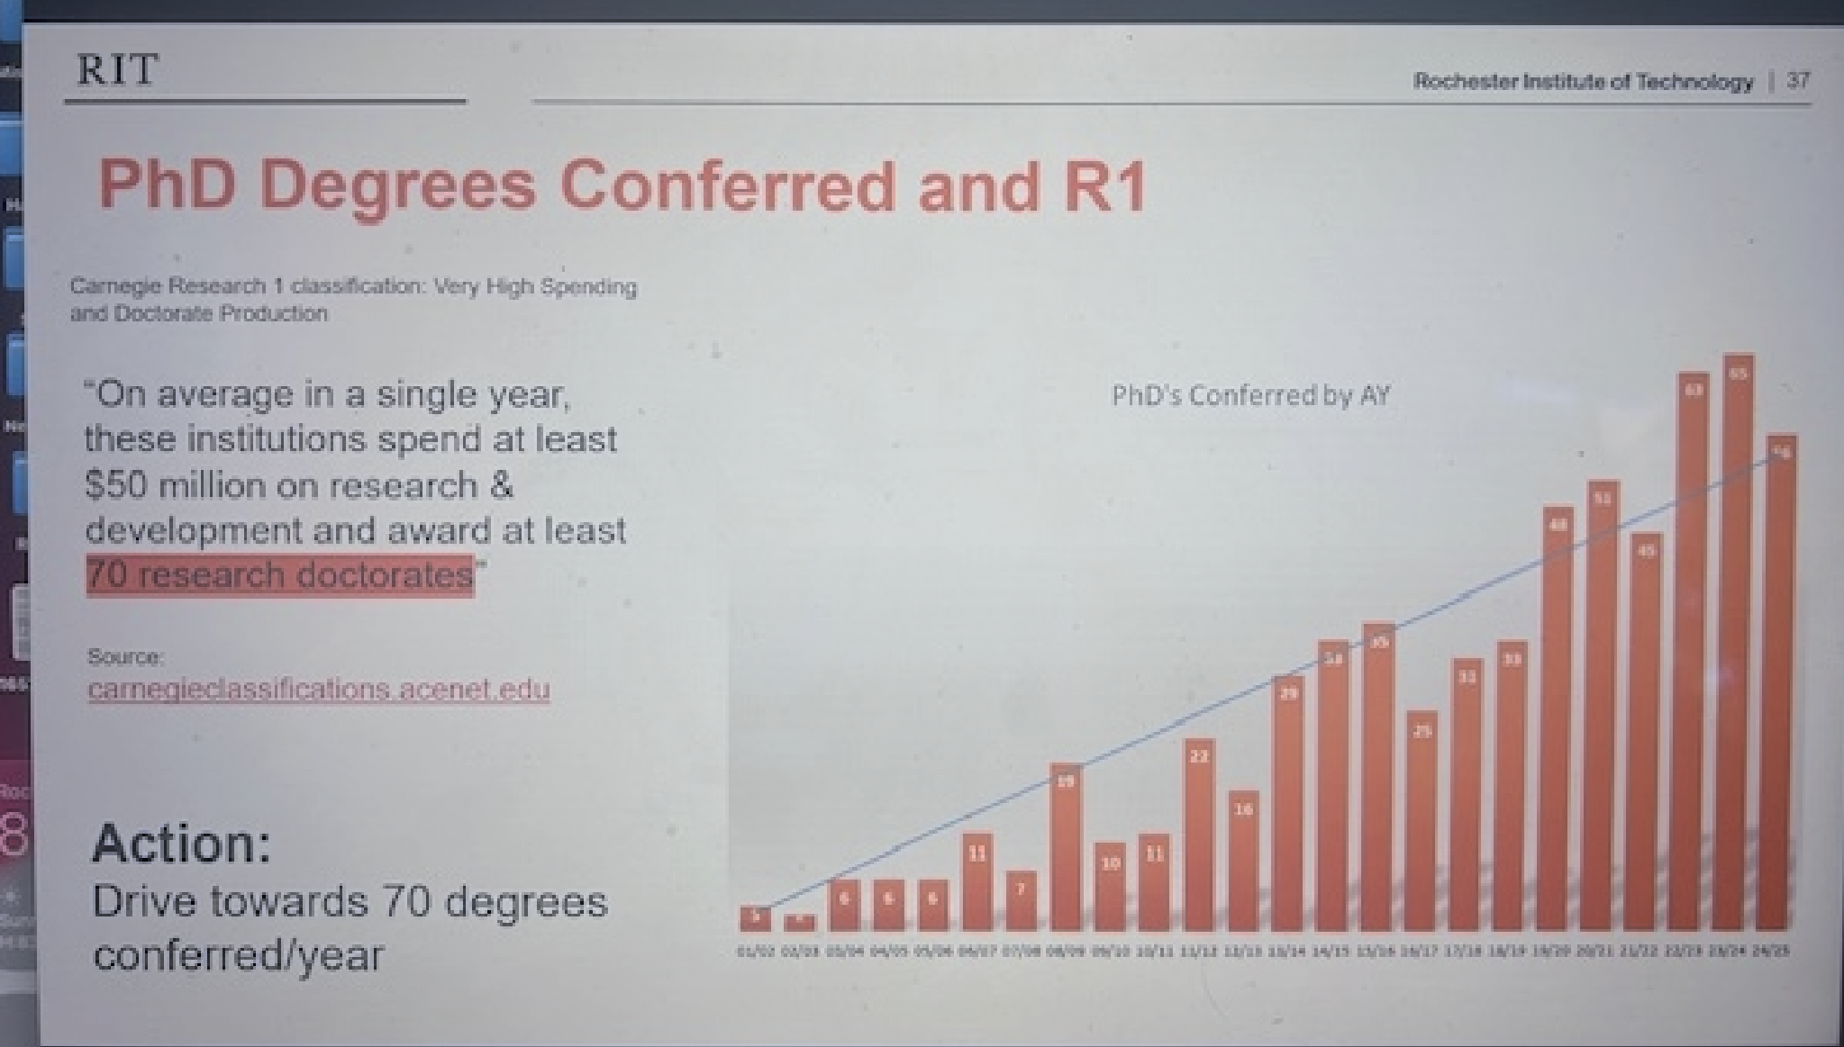
PhDs conferred

Slide 25
COACHE Survey

Slide 26
COACHE I
“You selected five comparison institutions – "peers" in the report – to represent those most similar to you in the faculty labor market.”
Clemson
Lehigh
Missouri U. of Sciences & Technology
Virginia Polytechnic
Worcester Polytechnic

Slide 27
COACHE II
Faculty are also asked to identify the two worst aspects of working at your institution. . . . The most frequently cited responses at your institution are highlighted in red.
Overall Pre-tenure Associate Women FOC
Compensation 30% 26% 30% 21% 32%
Teaching load 18% 4% 20% 18% 19%
Quality of leadership 16% 16% 16% 17% 10%

Slide 28
2018-2026 RIT Faculty Salary % Increment

Slide 29
2018-2026 RIT Faculty Salary % Increment
CPI |  |  |  | Merit | Market
2.40% |  | 2018 |  | 2.00% | ?
1.80% |  | 2019 |  | 2.00% | ?
1.40% |  | 2020 |  | 0.00% | 0.00%
7.00% |  | 2021 |  | 2.75% | 0.25%
6.50% |  | 2022 |  | 2.75% | 0.25%
3.40% |  | 2023 |  | 2.75% | 0.25%
2.90% |  | 2024 |  | 2.50% | 0.5%
2.70% |  | 2025 |  | 2.00% | 0.00%
3.40% |  | 2026 |  | 0.00% | 0.00%
https://projects.propublica.org/nonprofits/organizations/160743140/202631329339300713/full
Notes:
https://projects.propublica.org/nonprofits/organizations/160743140/202631329339300713/full

Slide 30
2026/27 Increments Around Us
Brockport: 4.5%
Genesee Community College: 3% plus $500 added to base
Geneseo: 4.5%
Monroe Community College: 2.75%
St. John Fisher: 2%
University of Rochester: 3%

Slide 31
IPEDS I
Integrated Postsecondary Education Data System
“The custom comparison group chosen by Rochester Institute of Technology includes the following 11 institutions”

Slide 32
IPEDS I
Case Western Reserve University
Clarkson University
Drexel University
Illinois Institute of Technology
Lehigh University
Northeastern University
Purdue University-Main Campus
Rensselaer Polytechnic Institute
Stevens Institute of Technology
University of Dayton
Worcester Polytechnic Institute

Slide 33
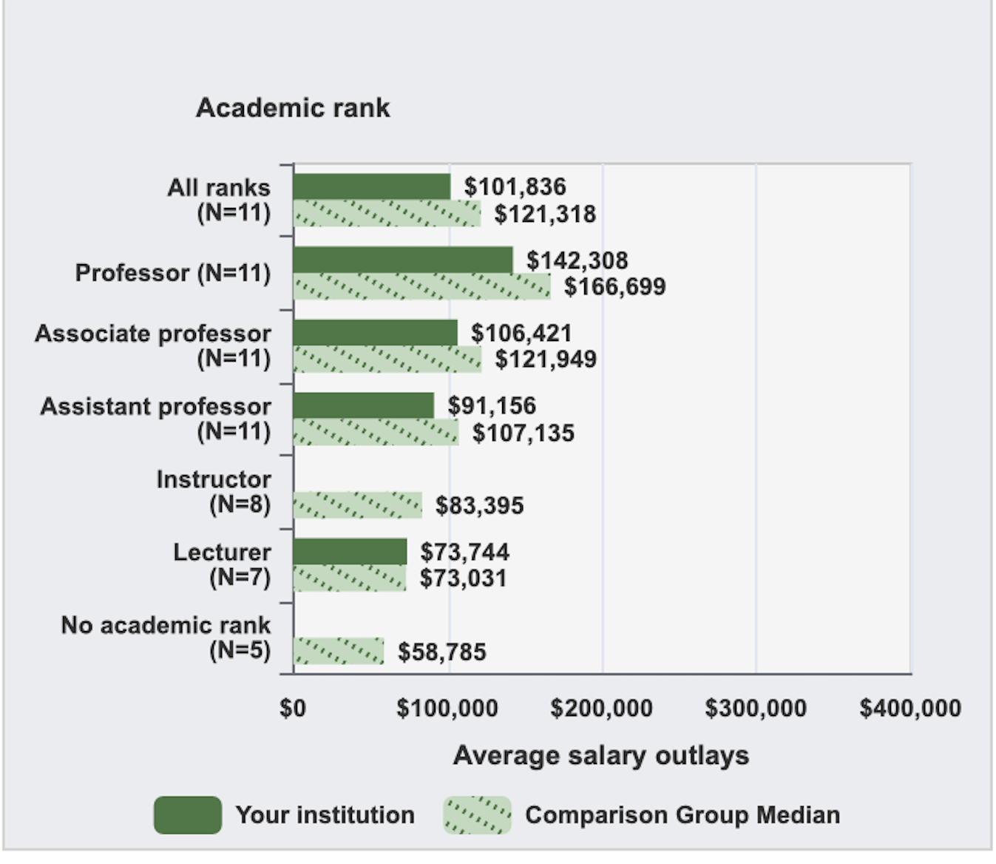
IPEDS II RIT Faculty Salary Comparison 2024

Slide 34
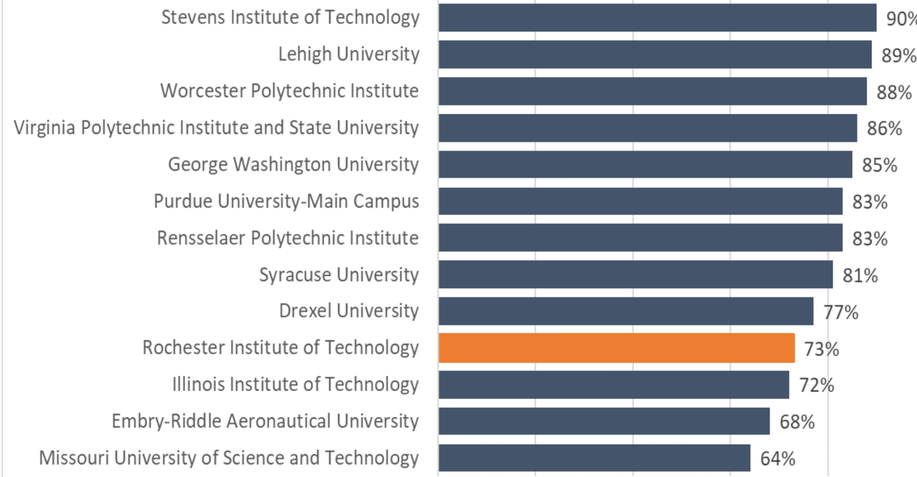
6-yr Graduation Rate of Peer Universities

Slide 35
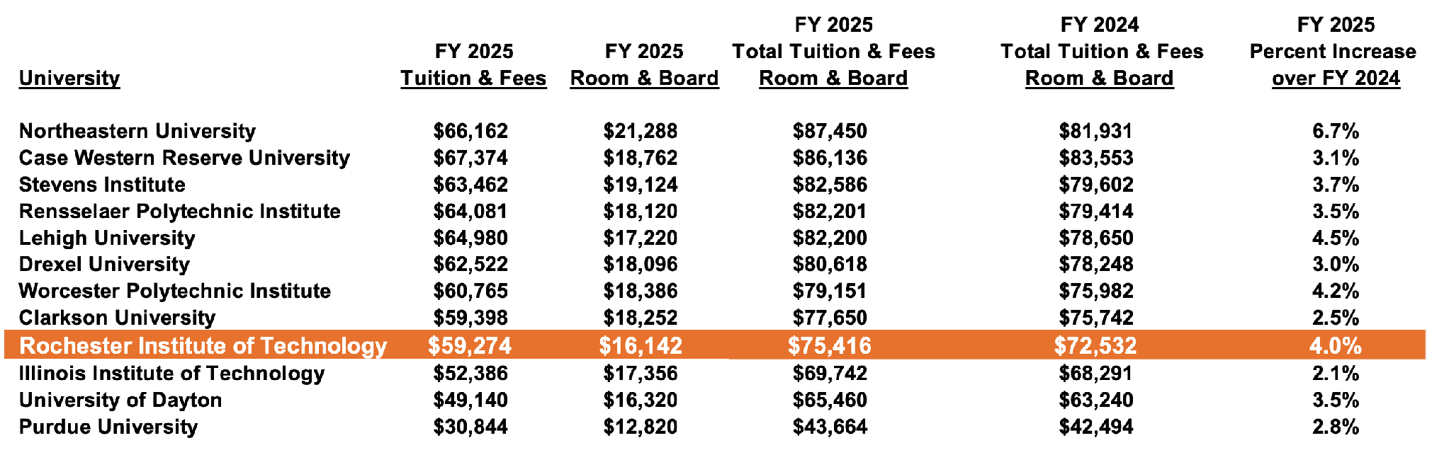
Student Benchmark Tuition Group
(Watters 11/21/24)

Slide 36
The Tortured History
of RIT Benchmarks

Slide 37
CAC Benchmark Group (n=29): 1994-2003

Slide 38
CAC Benchmark Group (n=29): 1994-2003
Alfred University California Institute of Technology
Clarkson CMU
Case Western Reserve Cooper Union
Cornell Drexel
Gallaudet University Harvey Mudd
Illinois Institute of Technology Ithaca College
Lehigh University MIT
Penn State RPI
Rice University Rose Hulman Institute of Technology
SUNY Albany SUNY Binghamton
SUNY Buffalo SUNY Geneseo
SUNY Oswego SUNY Stony Brook
Syracuse University University of Connecticut
University of MA (Amherst) University of Rochester
WPI

Slide 39
Benchmark Group (n=22): 2011-2020
Clarkson CMU
Case Western Reserve Cornell
Drexel Gallaudet University
Illinois Institute of Tech. Kettering
Lehigh University MIT
NYU Northeastern
Pace U. Purdue
RPI Rose Hulman Institute of Tech.
Stevens Institute of Technology SUNY Buffalo
Syracuse University University of Rochester
Virginia Polytechnic WPI

Slide 40
CUPA R1/R2 Benchmark Group (n=149): 2020 & 2024-2025

Slide 41
CUPA R1/R2 Benchmark Group (n=149): 2020 & 2024-2025
70 R1 institutions, of which just 27 ranked above RIT on US News & World Report.
63 institutions ranked between 200-400 on US News & World Report.
Clarkson Drexel
Lehigh University SUNY Buffalo Syracuse University Virginia Polytechnic WPI

Slide 42
Benchmark hiatus (2021-2024)
5/19/21
Colleagues,
. . . . . . .The university will expand the list of schools used for salary benchmarking to include all R1 and R2 schools that participate in the College and University Professional Association (CUPA) annual survey of faculty salaries. The expanded list of benchmark schools will significantly increase the availability of market data for a large number of our disciplines for which data was previously not available. No salary benchmarks will be reduced as a result of this change.
Best wishes for a great summer!
Ellen Granberg, Ph.D.
Provost and Senior Vice President for Academic Affairs

Slide 43
Faculty-HR email correspondence - July 2024
To HR:
… I am still trying to understand how the benchmark for full professors … dropped by 12% between last year and this year.
… Also, I am wondering what our benchmark schools are and whether these were changed over the past year, in what way. This might help me to understand the $15,000 drop in the benchmark for full professors in … over the past year.
I noticed that quite a few of the …benchmarks … have fallen dramatically in the last year or so.

Slide 44
Faculty-HR email correspondence - July 2024
From HR:
As you may recall, four years ago, Academic Affairs began the transition to combined R1 and R2 school data for salary benchmarking. The move to R1/R2 schools greatly increased the availability of market data across faculty ranks for RIT’s many disciplines. During the transition, Academic Affairs continued to use the AY19-20 benchmarks for any ranks/disciplines where the R1/R2 data was lower.
For the majority of faculty, the R1/R2 data now exceeds the AY19-20 benchmarks and the transition is complete. For consistency, all faculty benchmarks are based on R1/R2 school market data beginning with the 2024-25 academic year. The R1/R2 data is averaged over a three-year period.
I hope this information is helpful.

Slide 45
Faculty Compensation Review Committee

Slide 46
Faculty Compensation Review Committee
Charge:
To develop a set of approximately 100 benchmark schools for RIT to use for faculty salary benchmarking. This set can include both peer and aspirational schools, public and private, and should ensure an appropriate number of institutions are included to reflect various disciplines and ranks.
Recommendations should be provided to the provost by March 15, 2025.

Slide 47
Criteria for inclusion in the new benchmark
Two primary criteria (unchanged):
Institutions that report salary data to CUPA (College & University Professional Association)
Institutions that carry Carnegie designation of either R1 or R2
The two secondary criteria:
A large enough sample to cover all RIT programs (as determined by HR)
Institutions have a US News & World report ranking of under 150.

Slide 48
Benchmark Group (n=61): 2025-2026
61 institutions, of which 31 ranked lower than RIT on US News & World Report
45 R1, of which 18 ranked lower than RIT on US News & World Report
Highest ranked US News & World Report institution = U. Michigan at #20
Old Friends (from the 1994 benchmark)
Clarkson Drexel
Lehigh University SUNY Buffalo
Syracuse University University of Connecticut
University of MA (Amherst) WPI

Slide 49
President Munson’s initial response to the 61
From: David Munson
Date: Wednesday, April 9, 2025 at 4:10 PM
Subject: Re: Recommendations for Faculty Salary Benchmarking Final Report
… A bunch of these schools are nothing like us, but I understand that we cannot get data from all of the schools we'd like. At a minimum, I suggest deleting the following schools:
Illinois and Michigan
because they both have very top programs in computing and engineering. We are a really long way from either of these schools academically — we simply do not compete for the same set of faculty. We could take off Ga Tech on a similar basis, but at least Ga Tech is more like RIT.
Tulane, Pepperdine, and Creighton
because they are nothing like us — they don't even have real schools of engineering (Tulane offers biomedical and chemical engineering, but that's it).
Here are some schools we'd like to have on the list if they are part of the data pool:
Case Western, U. of Delaware, Penn State, Rutgers, Stevens
--Dave

Slide 50
ChatGPT’s recommended benchmark (n=25)

Slide 51
ChatGPT’s recommended benchmark (n=25)
Clarkson CMU
Case Western Reserve Drexel
Embry-Riddle Aeronautical U. Illinois Institute of Tech.
Kettering Lehigh University
Missouri U. of Sci. and Tech New Jersey Institute of Tech.
Northeastern Penn State
Purdue RPI
Rose Hulman Institute of Tech. Stevens Institute of Technology
SUNY Buffalo Syracuse University
University of Cincinnati University of Connecticut
University of MA Amherst University of Rochester
Virginia Polytechnic Wentworth Institute of Tech.
WPI

Slide 52
HR position - I
11/2019 Presentation to University Council
Position to Market, aka “compa-ratio,” is a moving target
50th percentile assumes fully functioning in all aspects of position – time is required to get to this level of competency
Market adjustment eligibility
Criteria: three or more years in grade/rank, and a compa-ratio of less than 88%, and a three-year average performance rating of 3.7 or higher

Slide 53
Compa-ratio
In HR parlance, a faculty member’s compa-ratio is the ratio of a faculty member’s full-time salary to a given benchmark
Compa-ratio = (Base Salary ÷ Benchmark) × 100

Slide 54
HR position – II
6/2025 Presentation to the Board of Trustees
“HR considers anyone within 85% of Benchmark to be at benchmark.”
“Our benchmarks are set at the 50th percentile of the full range of salaries”
“Thus, if A is paid 86% of Goal, they are at 86% of 50%”
“If the range is lowered, more salaries fit within the ‘benchmark.”

Slide 55
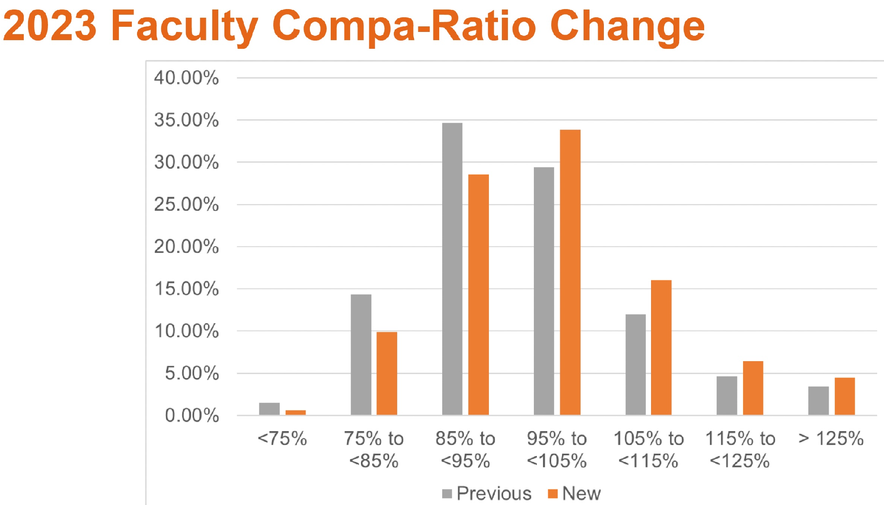
The 85th %ile in 2022 and 2023

Slide 56
HR position – III
6/2025 Presentation to the Board of Trustees
Faculty Excellence
Goal #4: Attract and retain world-class faculty
Metric c: Faculty salary relative to market (Goal: Achieve 100% by 2025)
Current: 99.7% for all ranks

Slide 57
Nothing new under the sun
These are not new issues. In 2015 the Research Allocation and Budget Committee of Academic Senate was charged with investigating four questions:
• Why is the 50th percentile the stated goal for faculty salaries?
• What is the reality of faculty salaries actually achieving even the 50th percentile?
• Is there a rubric by which salaries are being brought up to benchmark?
• Are there instances in which it would be acceptable for faculty salaries to remain below benchmark?

Slide 58
Nothing new under the sun
In its final report, the Committee noted that HR was unable to answer these questions “in an academically rigorous manner.”

Slide 59
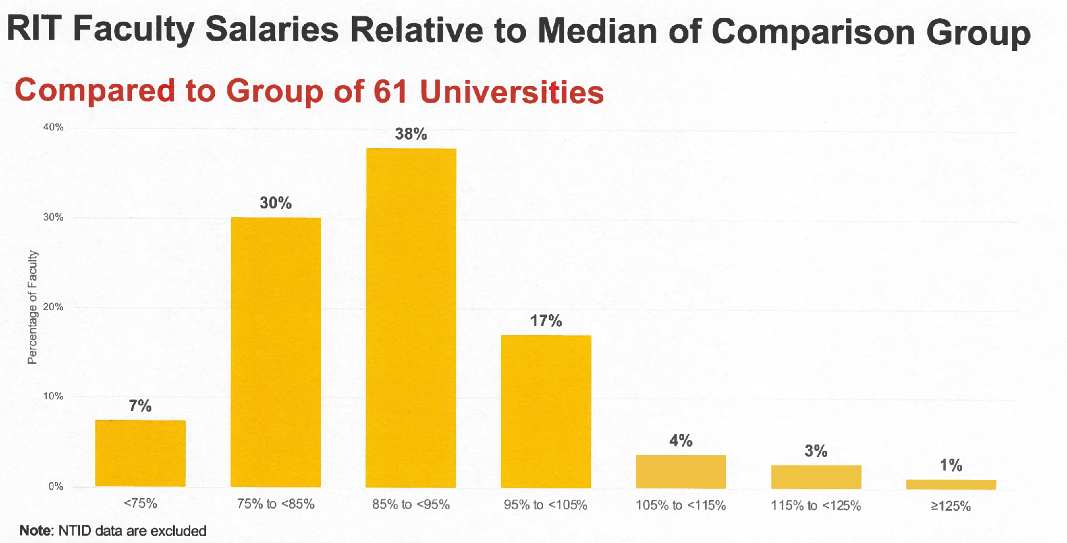
The 85th %ile in 2026

Slide 60
Calculate Your Compa-Ratio

Slide 61
College benchmark #s last four years

Slide 62
College benchmark #s last four years
College of Art and Design | 26/27 | 25/26 | 24/25 | 23/24 |  | 26/27 | 25/26 | 24/25 | 23/24 |  | 26/27 | 25/26 | 24/25 | 23/24
Tenure Track | Full | Full | Full | Full |  | Assoc | Assoc | Assoc | Assoc |  | Asstnt | Asstnt | Asstnt | Asstnt
Film and Animation | 126,940 | 117,120 | 112,449 | 114,730 |  | 103,590 | 91,610 | 88,197 | 87,476 |  | 84,340 | 78,730 | 75,946 | 73,377
School for American Crafts | 126,200 | 104,790 | 103,637 | 113,174 |  | 97,030 | 85,230 | 83,573 | 84,297 |  | 82,040 | 72,560 | 70,749 | 70,182
School of Art | 126,200 | 104,790 | 103,637 | 113,174 |  | 97,030 | 85,230 | 83,573 | 84,297 |  | 82,040 | 72,560 | 70,749 | 70,182
School of Art - Art History | 149,280 | 129,000 | 128,273 | 127,437 |  | 104,600 | 94,570 | 92,978 | 91,220 |  | 88,030 | 84,050 | 81,816 | 79,301
School of Design | 141,800 | 127,550 | 123,278 | 121,593 |  | 108,030 | 99,740 | 96,908 | 93,876 |  | 86,550 | 79,380 | 77,066 | 75,507
School of Photo Arts and Sciences | 126,940 | 117,120 | 112,449 | 114,730 |  | 103,590 | 91,610 | 88,197 | 87,476 |  | 84,340 | 78,730 | 75,946 | 73,377
Non Tenure Track | Princpl | Princpl | Princpl | Princpl |  | Senior | Senior | Senior | Senior |  | Lecturer | Lecturer | Lecturer | Lecturer
Film and Animation | 81,196 | 71,900 | 67,636 | 64,965 |  | 77,330 | 68,480 | 64,415 | 61,871 |  | 73,464 | 65,220 | 61,348 | 58,925
School for American Crafts | 71,284 | 64,630 | 62,055 | 59,228 |  | 67,890 | 61,550 | 59,100 | 56,407 |  | 64,496 | 58,620 | 56,286 | 53,721
School of Art | 71,284 | 64,630 | 62,055 | 59,228 |  | 67,890 | 61,550 | 59,100 | 56,407 |  | 64,496 | 58,620 | 56,286 | 53,721
School of Art - Art History | 80,566 | 68,500 | 67,474 | 59,228 |  | 76,730 | 65,240 | 64,261 | 56,407 |  | 72,894 | 62,130 | 61,201 | 53,721
School of Design | 86,488 | 72,780 | 69,190 | 72,411 |  | 82,370 | 69,310 | 65,895 | 68,963 |  | 78,252 | 66,010 | 62,757 | 65,679
School of Photo Arts and Sciences | 81,196 | 71,900 | 67,636 | 64,965 |  | 77,330 | 68,480 | 64,415 | 61,871 |  | 73,464 | 65,220 | 61,348 | 58,925

Slide 63
E.4 Faculty Employment Policies
Section V: Salary Considerations
Annual Salary Review
Benchmarking Salaries
Salary Appeals

Slide 64
Benefits Review
RIT Benefits Outline

Slide 65
Benefits Information
  RIT offers a broad range of benefits to its employees, from healthcare and retirement, to legal services and identity theft protection. There is a lot of information to be absorbed.
Key areas of concern are:
What is covered
What it costs the employee.

Slide 66
Benefits Information
  RIT offers a broad range of benefits to its employees, from healthcare and retirement, to legal services and identity theft protection. There is a lot of information to be absorbed.
Key areas of concern are:
What is covered
What it costs the employee.
What is easily overlooked: Changes from year to year.
HR does not record when a policy was changed.

Slide 67
Updates vs Re-Enrollment
  This year, we see a shift from implicit to explicit consent.
  You are being asked to re-enroll in everything, not just medical benefits.
  An explicit re-enrollment likely means that the terms and conditions have been changed under the hood.
  The documentation of the updates have not yet been shared (as of this prep)
Look for extreme drops in coverage.

Slide 68
Factors to Consider
Medical Co-pays
Deductible Amounts - Individual and Family Deductibles
“Family plans can have embedded deductibles, which include both individual and family deductibles, or they can function as an aggregate deductible, which means that insurance doesn’t pay until the entire family deductible is met.”
RIT has an embedded deductible.
Notes:
https://www.verywellhealth.com/health-insurance-deductible-what-it-is-how-it-works-1738655

Slide 69
Factors to Consider
Don’t forget to look for and understand:
The Co-insurance model that was adopted 5 years ago.
Coverage of name-brand vs generic medication
RIT-specific = Hearing aids and related coverage
RIT also tends to edit benefits in other areas, such as Retirement Contributions!
Notes:
https://www.verywellhealth.com/health-insurance-deductible-what-it-is-how-it-works-1738655

Slide 70
Retirement Plans
401K and Beyond

Slide 71
Retirement Contributions
If you put in 5%, they pay 9% (only base salary)
4% is double-match and 1% is even.
Anything below is leaving money on the table. No match on additional %.
Any changes on the terms should be to go forward. If they do claw-back (like they did in 2019), it is a problem.

Slide 72
Retirement Contributions
If you put in 5%, they pay 9% (only base salary)
4% is double-match and 1% is even.
Anything below is leaving money on the table. No match on additional %.
Any changes on the terms should be to go forward. If they do claw-back (like they did in 2019), it is a problem.

Slide 73
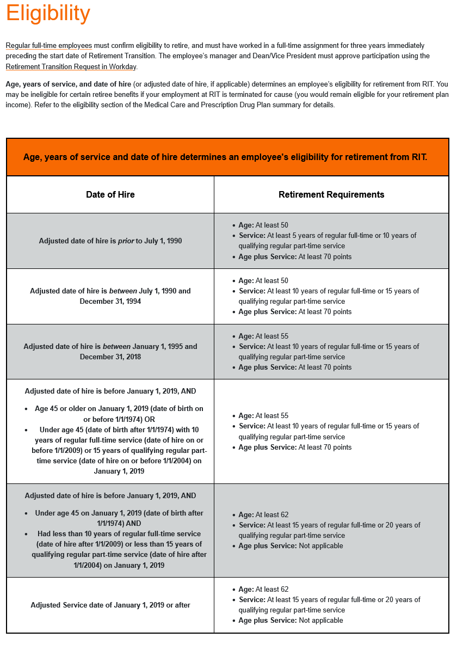
10-Year Claw-Back!

Slide 74
10-Year Claw-Back!

Slide 75
Self-Insurance
AI Summary:
When your employer is self-insured, it means they take on the financial responsibility for paying your medical claims directly, rather than purchasing a traditional insurance policy from an insurance company. This allows employers to customize their health plans and potentially save on costs, but they also assume the risk of higher medical expenses.

Slide 76
Self-Insurance
However…
“self-insuring can provide financial savings as well as the option to tailor-make a health plan to suit the employer’s and employees’ needs.”
“But state-based laws and regulations only pertain to fully insured plans—they do not apply to self-insured plans.”
Notes:
https://www.verywellhealth.com/what-is-self-insured-health-insurance-and-how-is-it-regulated-4688567
https://www.cms.gov/marketplace/private-health-insurance/medical-loss-ratio

Slide 77
Recent Change
RIT offers employer-sponsored retiree health benefits through Medicare Advantage Plans.
RIT provides a $2000 HSA (Health Savings Account) for retirees.
Just reduced 25% from that $$ allowance this year!
Notes:
https://www.medicare.org/articles/how-does-medicare-work-with-employer-insurance/

Slide 78
Education Benefits
Go to School!

Slide 79
Education Benefits
Many RIT faculty are here because they want to support their children through college. This is a huge reason for faculty retention and should be considered as such.
Yet, our education benefits have been under scrutiny for years, and continue to be reduced in small increments.

Slide 80
Education Benefits
Used to include all family members;
now only includes children
Used to include both Masters and Undergraduate degrees;
now only covers undergraduate
Used to cover employee’s degrees;
now does not fully cover Masters

Slide 81
Medical Benefits
A Quick Look

Slide 82
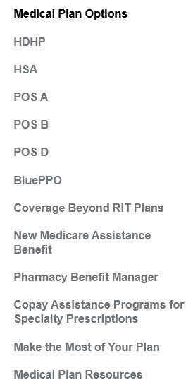
Medical Plans
HR has been celebrating the fact that we now have more Plan Options.
The sense is that most employees are needlessly choosing expensive plans instead of going for something like HDHP.
This year, I noticed “Coverage beyond RIT” as an option.
*Employees are paying different amounts if they are on less than a 12-month contract.*

Slide 83
Drug Coverage
Pharmacy benefit agreements have shifted: Wegmans may not be the best option as a provider!
It is worth it to check alternate drug coupon sites like GoodRx to see if your drug costs can be lowered futher.
It is work, but some external cards will lower medicine costs by as much as 50%!
BTW: any coupon applications need to be checked per drug each time. Wegmans pharmacy does not automatically check to see which source of coverage is lowest cost for you.

Slide 84
Medical Insurance Pay Bands
1 - less that $51,000
2 - $51,000 - $108,999
3 - $109,000 - $161,999
4 - $162,000 or more
5 - Part-time Employees (assuming Staff and Adjuncts)

Slide 85
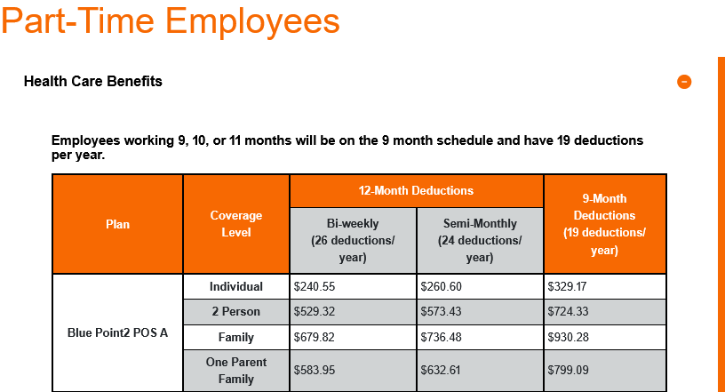
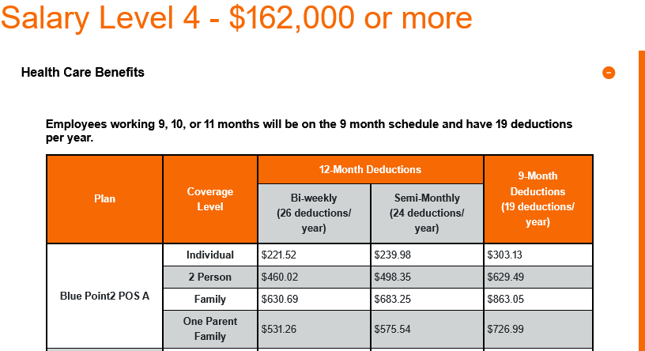
Part-Time Faculty Pay More than our top salary tier!!

Slide 86
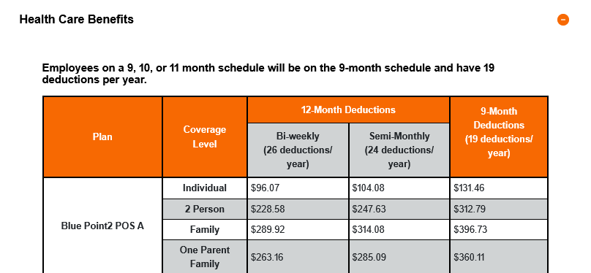
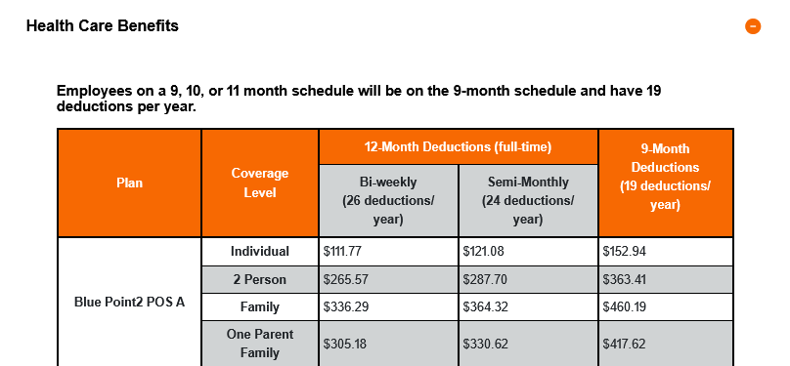
We have a .pdf to help you compare the 2025 vs
2026 Plan costs

Slide 87
Takeaways
Being informed is key.
*Remember, RIT’s policies are your employment contract.*
If you are not involved, you are allowing your contract to be rewritten without your consent.

Slide 88
The RIT Budget
?

Slide 89
The Debt

Slide 90
The Debt
 | FY25 |  | FY24 |  | FY23
Net Long term debt | $420,973 | Net Long term debt | $435,391 | Net Long term debt | $449,297
Interest expense | $10,247 | Interest expense | $10,247 | Interest expense | $8,578
Payments of long-term debt | $12,182 | Payments of long-term debt | $11,648 | Payments of long-term debt | $12,157
Total long-term debt | $420,973 | Total long-term debt | $435,391 | Total long-term debt | $449,297
Schdld. principal payments |  | Schdld. principal payments |  | Schdld. principal payments
2026 | $12,544 | 2025 | $12,174 | 2024 | $11,590
2027 | $13,047 | 2026 | $12,509 | 2025 | $12,132
2028 | $13,258 | 2027 | $13,010 | 2026 | $12,466
2029 | $16,465 | 2028 | $13,220 | 2027 | $12,984
2030 | $18,051 | 2029 | $16,425 | 2028 | $13,220
Thereafter | $316,890 | Thereafter | $334,910 | Thereafter | $351,335

Slide 91
The Capital Budget (10/25)

Slide 92
The Capital Budget (10/25)
Performing Arts Building $74.4 million
Tiger Stadium $30 million
Booth & Gannett AC $11 million
CHST Occupational Therapy $5.8 million
Battery Prototyping Center $2.25 million
TAIT Preserve Classroom $2.1 million
RIT Certified (100 Park Point) $1.325 million
Other $48.639 million

Slide 93
The Endowment

Slide 94
The Endowment
2016 = $754 million
2025 = $1.475 billion
Office of University Advancement = 79 positions
2026 Contribution to Operating = $22.9 million
5-year average total contribution = 5.25% ($62.9 million)
NYS-authorized percentage = 7%
3-year appropriation for Marketing & Communication = $15 million

Slide 95
A Case in Point: RIT Certified

Slide 96
A Case in Point: RIT Certified
12/9/21: Ian Mortimer came to Academic Senate: “RIT Certified has taken a loan from RIT to build this out on behalf of Academic Affairs. Starting this year, we’ll be producing revenue.”
June/22: Beginning of RIT Certified announced
11/15/22: Mortimer: “There is loan provided by central that requires annual revenue targets to be met. The excess revenue, after paying back central, funds strategic priorities in Academic Affairs. There is a revenue expectation for the end of this fiscal year, with a small return to AA. Returns become more sizeable over time.”
12/22: Ian Mortimer left to head the Golisano Institute for Business, replaced by Dennis DiLorenzo
11/13/23: Munson meeting w/ Exec Committee: “I’m not sure whether RIT Certified is going to pan out. I’m giving it til the end of this year.
3/5/25: Rosalie Clemens appointed director
10/26: RIT Certified website lists 16 members, including two associate directors.

Slide 97
What Can Be Done?

Slide 98
What Can Be Done?
Enhancements to formal faculty governance:
  • Voting faculty member on the BoT
  • Take B2 seriously re: budget
  • Establish a faculty cabinet in the President’s office
  • College-based compensation committees

Slide 99
What Can Be Done?
Independent Financial Audit

Slide 100
What Can Be Done?
  Other?

